Slide 1
Paying for College
Kerry Lubold
Assoc Dir of Fin Aid
SUNY Plattsburgh
www.plattsburgh.edu

Slide 2
1) College Research
Type of Education | Vocational training Certificate | 2 year degree 4 year degree
Academic Programs | Majors Minors | Concentrations Specializations
Academic Enrichment | Study abroad Assistantship | Internships Externships
Social/Campus Activities | Athletic Creative | Cultural Greek
Location | Accessible Distance to/from home | Safe Distance to experiences
Quality of Education | Faculty excellence Class size | Support services Access to advising
Advancement to Career Goals | Graduation rates | Placement rates

Slide 3

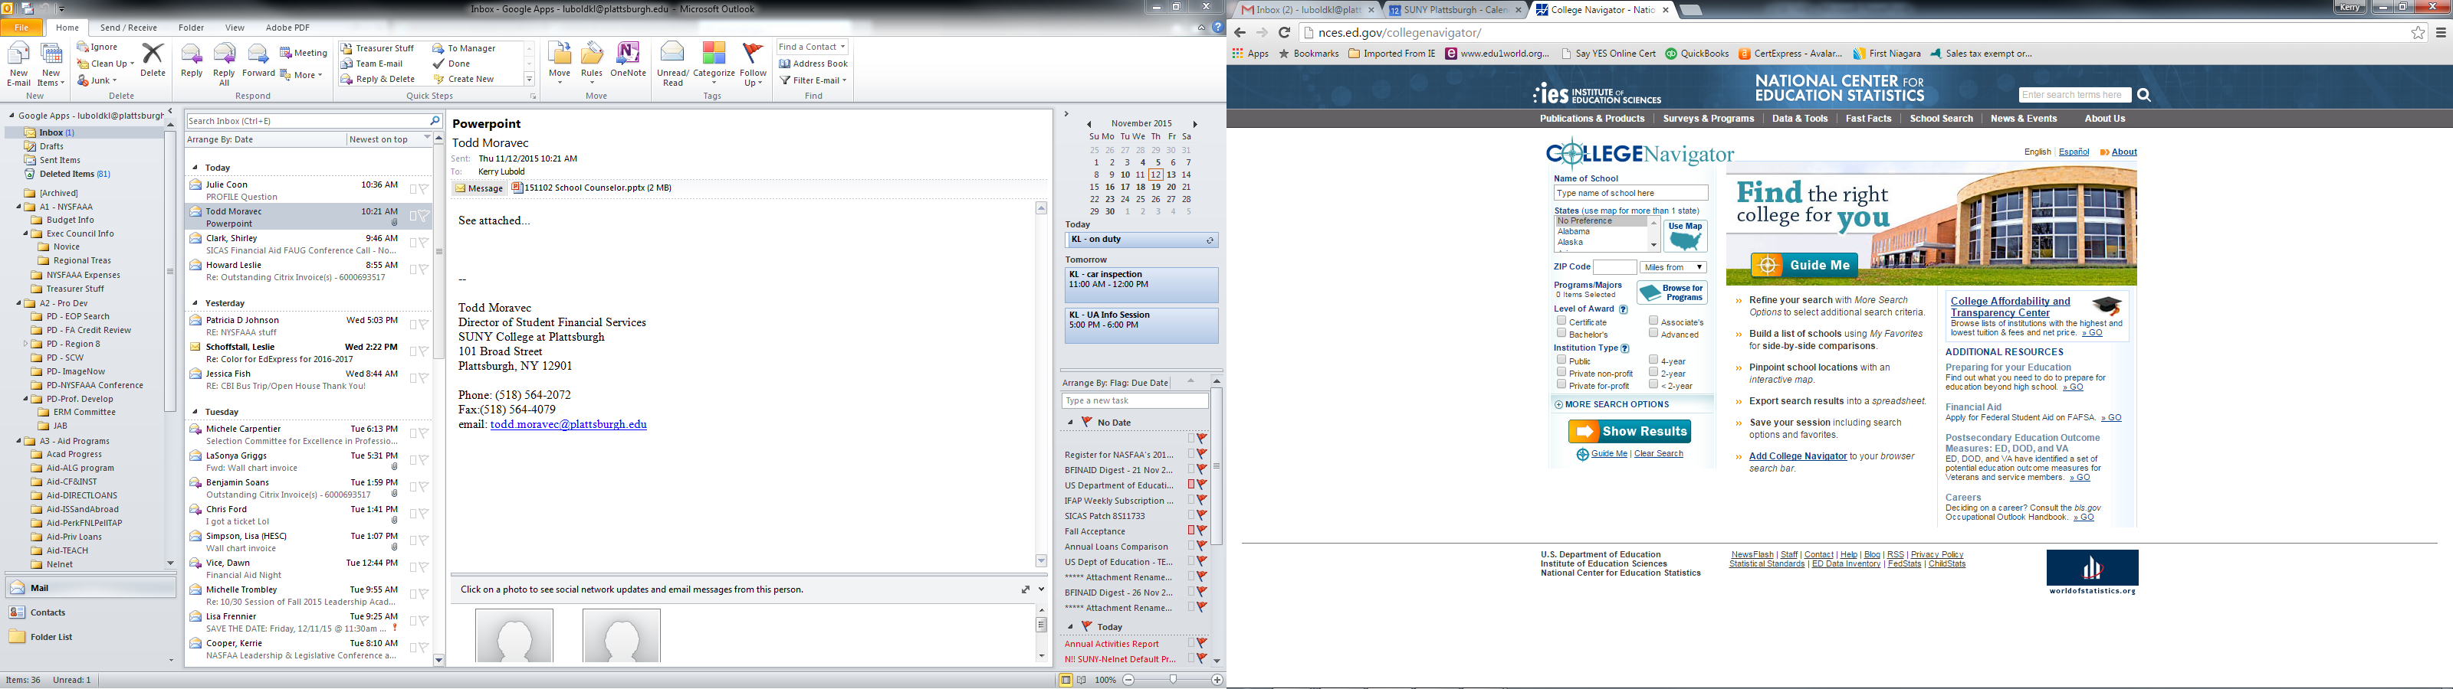
bigfuture.collegeboard.org
nces.ed.gov/collegenavigator

Slide 4

2) Family huddle – how are we paying for college?
How much does college (or other higher ed.) cost?
How much can we afford? (saved ahead or during)
Is student and/or parent borrowing an option?
What other costs do we need to prepare for?
What can we do to minimize college costs?
Explore costs on your college websites
Use the net price calculator

Slide 5
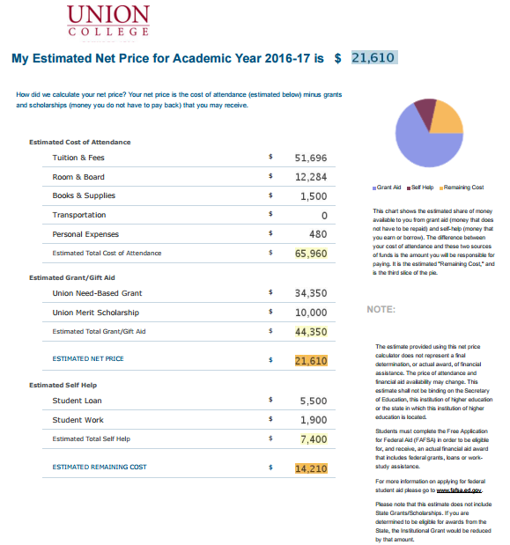
calculate your
estimated cost
with the
Net Price
Calculator

Slide 6
16-17 Direct Costs | Adirondack CC | Plattsburgh | D’Youville | Hartwick
Tuition | 4,176 | 6,470 | 24,740 | 42,050
Fees | 288 | 1,725 | 510 | 1,210
Room | 7,380 | 7,640 | 12,480 | 6,055
Board | 3,410 | 4,440 | 3,434 | 5,455
Estimated Total of Direct Costs | $15,254 | $20,275 | $41,164 | $54,770
Indirect Costs (varies student to student)
Books/Supplies $1,200
Transportation $ 700
Personal/Living $1,810
$3,710
Higher cost does
NOT necessarily mean
more costly…

Slide 7
3) apply for federal aid
Pell Grants TEACH Grants Student Loans
SEOG Grants Work-Study Parent Loans
Get your FSA ID at fsaid.ed.gov
both the student and one parent will need FSA ID’s
Apply after October 1st at www.fafsa.gov
meet your colleges recommended application deadline
Respond timely to all requests for info
- requests are made via email or thru your college portal
- verification, data conflicts and other review processes may occur

Slide 8
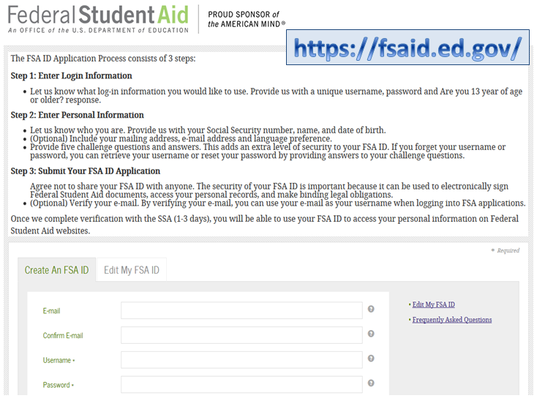
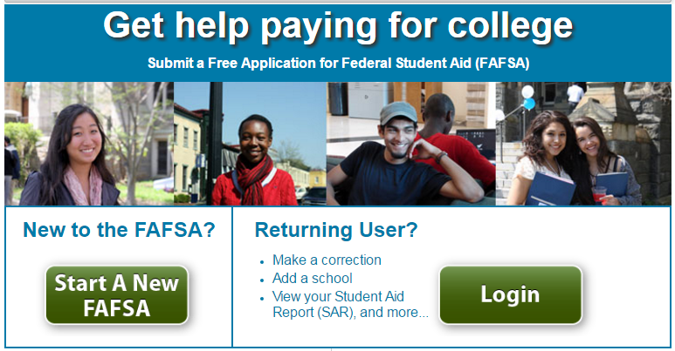
www.fafsa.gov

Slide 9
info needed to apply for financial aid
Social Security Numbers
Parent and/or student income tax information
  - Federal 1040/A/EZ and W-2 form(s)
  - Records of untaxed income
  such as child support received, interest income
Information on cash, savings, & checking account balances
Investment values such as stocks, bonds, real estate, college savings accounts (529 plans)
Not Reported ON THE FAFSA => Primary home, Social Security
Disability, Designated retirement accounts & Life
insurance policies

Slide 10
4) apply for NYS Aid
Apply for the NYS TAP Grant * via:
Follow the link from the FAFSA submission page
Or go direct to www.tapweb.org
Visit hesc.ny.gov => Grants, Scholarships, Awards
Learn about other state aid programs*
Use the TAP Award Estimator
Visit StartHereGetThere.org and GoCollegeNY.org Student aid and college planning tools and other
resources for college-bound families
* Must be attending a NYS college

Slide 11
5) apply for free aid
Guidance Office
College Websites
Around the Web
collegeboard.org petersons.com
fastweb.com scholarships.com
Community & Gov’t Sponsors
Key Club, Boy/Girl Scouts of America, Model UN, 4-H, Football Boosters, National Honor Society, Union Affiliations, Moose Lodge, Kiwanis, American Legion, Church or Synagogue, etc.
Employers (Student & Parents)
tuition reimbursement, interest free loans, scholarships, etc.

Slide 12
www.yourcollegewebsite.edu
how to apply for aid
dates and deadlines
scholarship info
college costs
web portal
CSS PROFILE
profileonline.collegeboard.com
16-17 PROFILE Student Guide
Participating Colleges & Programs

Slide 13
6) respond every time and on time
Communications may occur in paper
but more likely will be electronic
Email notifications
Online/web access via student portal
Possible parent and/or guest accounts available
MOST often the communication is sent to the student, not the parent

Slide 14
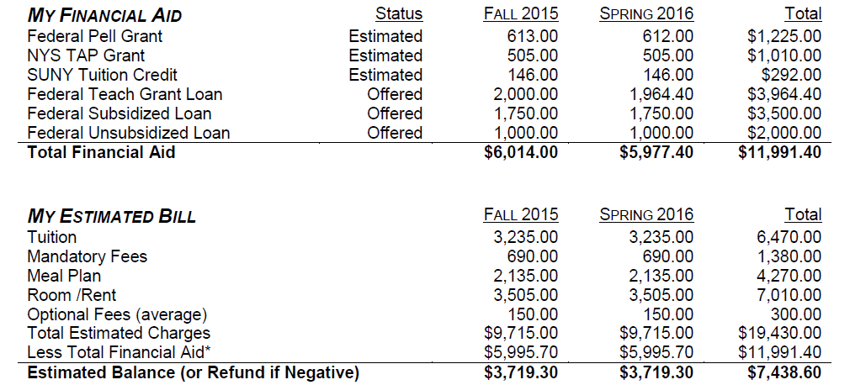
7) review your award letters
- Lists the types of aid and amounts that you qualify for
- Provides instruction for accepting, declining, or finalizing the awards

Slide 15
How Financial Aid Is Determined
 | College A | College B | College C
COA | $ 11,000 | $30,000 | $60,000
- EFC | 5,000 | 5,000 | 5,000
= Need | $ 6,000 | $ 25,000 | $55,000
Financial need can be met with various resources like:
- free money (grants & scholarships)
- subsidized student loans (no interest in school)
- self-help (work-study)

Slide 16
8) Consider options for paying
Payment Plans (college specific)
Personal Resources (savings, investments)
Education Loans (federal or alternative)
- Federal Student Loans
subsidized and unsubsidized
- Federal Parent PLUS Loans
- Alternative Student Loans
thru private banks/lenders
College Costs
Financial Aid
= What You Owe

Slide 17

Federal Student Loans at a Glance
Subsidized: no interest while in school
Unsubsidized: interest charged thru entire life of loan
Current Rates: 3.76% interest and 1.069% fees
Base Sub/Unsub Add’l Unsub
1st year undergrad $3,500 + $2,000
2nd year undergrad $4,500 + $2,000
3rd year undergrad $5,500 + $2,000
4th year undergrad $5,500 + $2,000
Federal Parent (PLUS) Loans at a Glance
Eligible Borrower: meet credit, citizenship, non-default criteria
Eligible Amounts: COA – Other Aid = Max PLUS Loan
Current Rates: 6.31% interest and 4.276% fees

Slide 18
9) communicate your concerns
Changes in Family Income (retirement, unemployment)
Change in Marital Status (widowed, divorced, separated)
Involuntary Dissolution of Family Unit (parental abandonment or separation from parent due to neglect or abuse)
Other Challenges
- Academic - Psychological
- Adjustment - Environmental
- Social - Time Management

Slide 19

10) Repeat every year until graduation!
Kerry Lubold, SUNY Plattsburgh
luboldkl@plattsburgh.edu
(518) 564-2072

